Slide 1


Tours and travels website
“ Explore the world And Travel with trust. ”

Slide 2
TEAM MEMBERS
NAME : RUDANI JAY ENROLLMENT NO : 24002171210157
BATCH : B4
BRANCH : CSE
NAME : BHOJANI NISARG
ENROLLMENT NO : 24002171210017
BATCH : B4
BRANCH : CSE
NAME :VAGHELA YOGRAJSINH
ENROLLMENT NO : 24002171210198
BATCH : B4
BRANCH : CSE

Slide 3
INTRODUCTION
Tours and Travels is all about helping people to plan their trips from start to finish without any stress.
It’s a huge Business that connects everything what a Traveler needs like finding a beautiful place to visit, booking a comfortable hotel to stay in and picking the best spots to eat.
Instead of people having to figure out everything on their own, travel platforms act like a digital helper that brings all these choices into one place.
The main goal is to make the journey easy and fun, so the traveler can focus on enjoying their vacation while the technology handles the boring stuff like prices, bookings, and schedules.

Slide 4
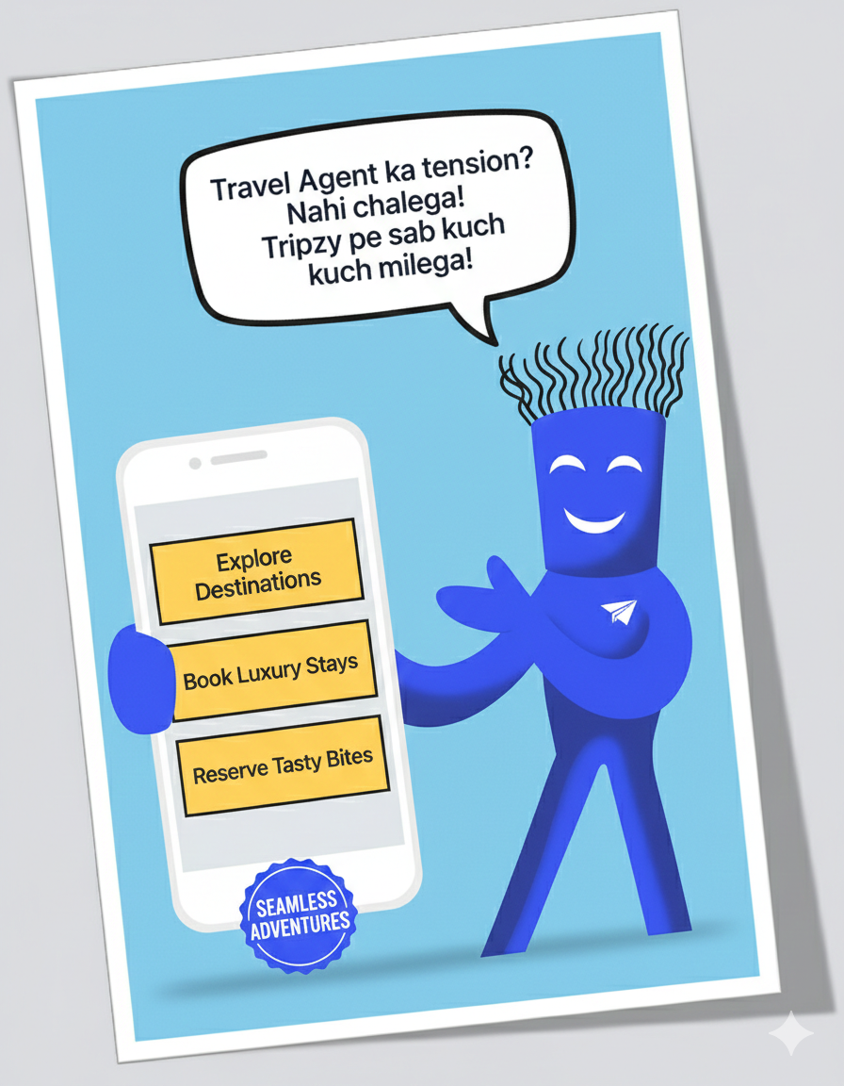
Functionalities
1. The user entry-
Unified Access
Secure Authentication
Live Status
2. The Discovery-
Curated data
Smooth User Experience
Instant search
3. The Booking-
Auto Invoicing
Offer logic
Persistent data
4. The Services-
One click tables
Unique identity
Complete loop

Slide 5



Share Your Moments: beyond destinations
By engaging with Tripzy , sharing your life’s dreams and plannings has been easier.
It takes the role of a digital entry that manages the three pillars of a trip: where to go, where to stay, and where to eat.
Explore
RESIDENCE
DINE
Navigate a perfect collection of global destinations with dynamic search.
Experience premium hospitality with an automated booking engine that handles taxes, discounts, and instant invoicing.
Secure your seat at the best food courts and restaurants with seamless table reservations.

Slide 6
TECH STACK OVERVIEW :
Frontend Development (UI/UX)
HTML5 & CSS3
Bootstrap 5
Aos (animate on scroll)
Fontawesome
Logic & Functionality (Client Side)
Vanilla Javascript (ES6+)
Custom modulesSimulated backend
Data & Storage
Web storage API:
LocalStorage
SessionStorage
Integration & Utilities
Ui-avatars API
Aos library

Slide 7
Future scope
AI Travel buddy: A smart assistant that suggests trips based on your mood.
Virtual reality (VR) tours: Walk through the hotel room using your phone before you book it.
Paperless Identity: Use your face or phone to check into hotels no physical Ids needed.
Eco-friendly travels: Show green scores to help travelers save the planet while they explore.
Global partnership: Working with local guides and hidden cafes to give you experiences nobody else has.

Slide 8
Thank You!!

